Slide 1
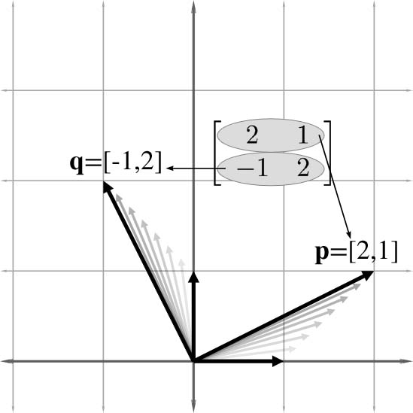
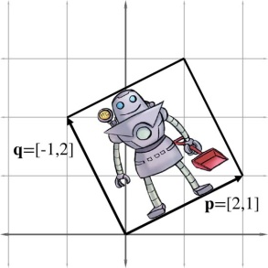
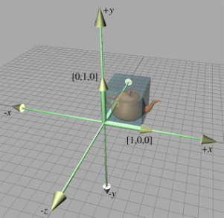
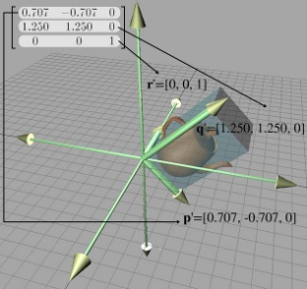
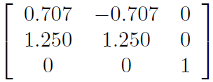
Chapter 4: Introduction to Matrices
Fletcher Dunn
Valve Software
Ian Parberry
University of North Texas
3D Math Primer for Graphics and Game Development

Slide 2
What You’ll See in This Chapter
This chapter introduces matrices. It is divided into three sections.
Section 4.1 discusses some of the basic properties and operations of matrices strictly from a mathematical perspective.
Section 4.2 explains how to interpret these properties and operations geometrically.
Section 4.3 puts the use of matrices in this book in context within the larger field of linear algebra, and is not covered in these notes.

Slide 3
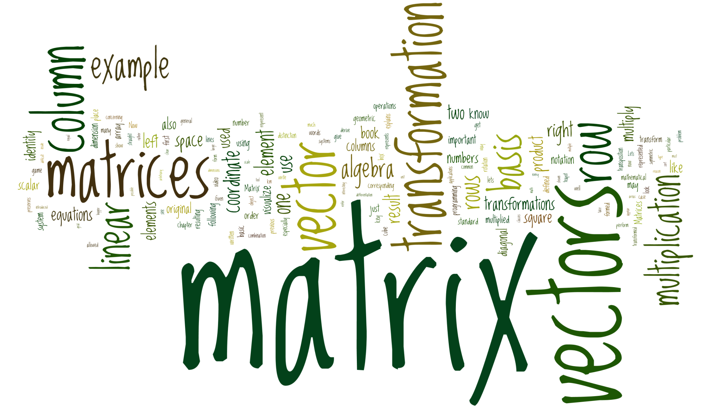
Word Cloud

Slide 4
Section 4.1: Matrix: An Algebraic Definition

Slide 5
Definitions
Algebraic definition of a matrix: a table of scalars in square brackets.
Matrix dimension is the width and height of the table, w x h.
Typically we use dimensions 2 x 2 for 2D work, and 3 x 3 for 3D work.
We’ll find a use for 4 x 4 matrices also. It’s a kluge. More later.

Slide 6
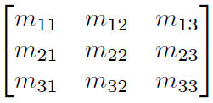
Matrix Components
Entries are numbered by row and column, eg. m_{ij} is the entry in row i, column j.
Start numbering at 1, not 0.

Slide 7
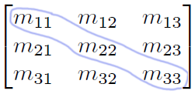
Square Matrices
Same number as rows as columns.
Entries m_{ii} are called the diagonal entries. The others are called nondiagonal entries

Slide 8
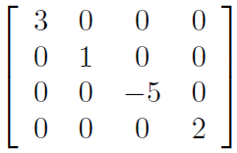
Diagonal Matrices
A diagonal matrix is a square matrix whose nondiagonal elements are zero.

Slide 9
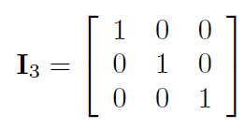
The Identity Matrix
The identity matrix of dimension n, denoted I_{n}, is the n x n matrix with 1s on the diagonal and 0s elsewhere.

Slide 10
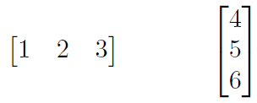
Vectors as Matrices
A row vector is a 1 x n matrix.
A column vector is an n x 1 matrix.
They were pretty much interchangeable in the lecture on Vectors.
They’re not once you start treating them as matrices.

Slide 11
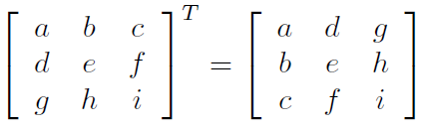
Transpose of a Matrix
The transpose of an r x c matrix M is a c x r matrix called M^{T}.
Take every row and rewrite it as a column.
Equivalently, flip about the diagonal

Slide 12
Facts About Transpose
Transpose is its own inverse: (M^{T})^{T} = M for all matrices M.
D^{T} = D for all diagonal matrices D (including the identity matrix I).

Slide 13
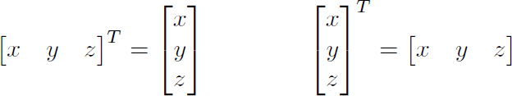
Transpose of a Vector
If v is a row vector, v^{T} is a column vector and vice-versa

Slide 14
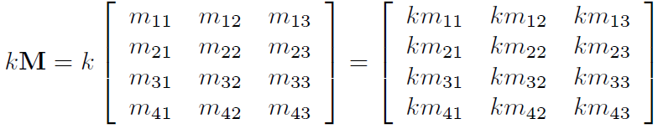
Multiplying By a Scalar
Can multiply a matrix by a scalar.
Result is a matrix of the same dimension.
To multiply a matrix by a scalar, multiply each component by the scalar.

Slide 15
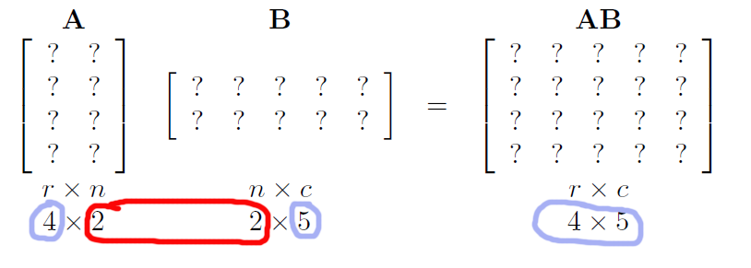
Matrix Multiplication
Multiplying an r x n matrix A by an n x c matrix B gives an r x c result AB.

Slide 16
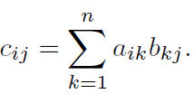
Multiplication: Result
Multiply an r x n matrix A by an n x c matrix B to give an r x c result C = AB.
Then C = [c_{ij}], where c_{ij} is the dot product of the ith row of A with the jth column of B.
That is:

Slide 17
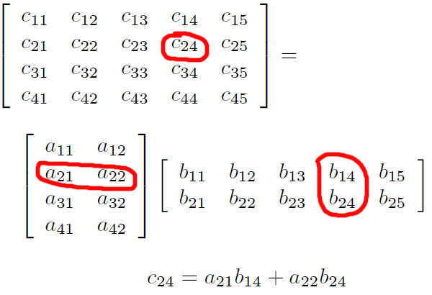
Example

Slide 18
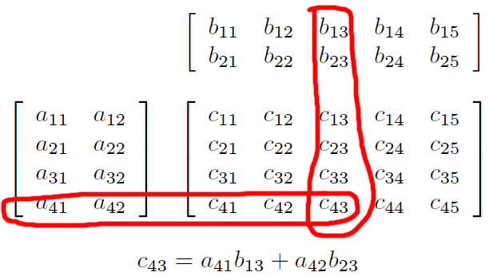
Another Way of Looking at It

Slide 19
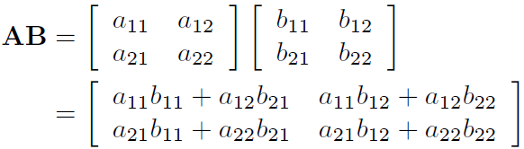
2 x 2 Case

Slide 20
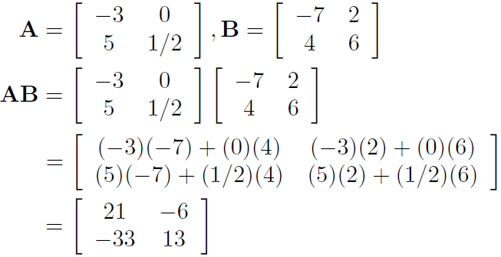
2 x 2 Example

Slide 21
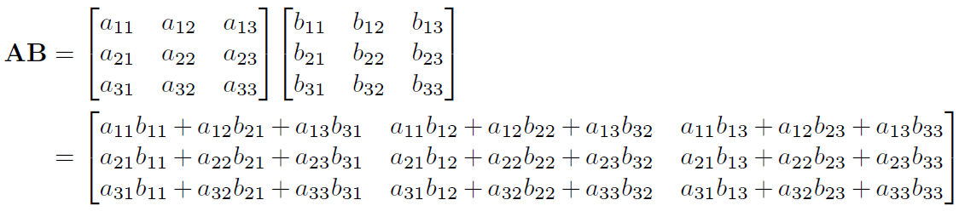
3 x 3 Case

Slide 22
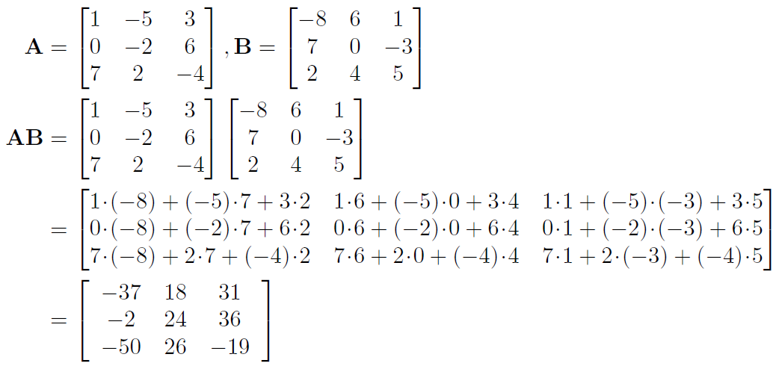
3 x 3 Example

Slide 23
Identity Matrix
Recall that the identity matrix I (or I_{n}) is a diagonal matrix whose diagonal entries are all 1.
Now that we’ve seen the definition of matrix multiplication, we can say that IM = MI = M for all matrices M (dimensions appropriate)

Slide 24
Matrix Multiplication Facts
Not commutative: in general AB ≠ BA.
Associative:
(AB)C = A(BC)
Associates with scalar multiplication:
k(AB) = (kA)B =A(kB)
(AB)^{T} = B^{T}A^{T}
(M₁M₂M₃…M_{n})^{T} = M_{n}^{T} …M₃^{T}M₂^{T}M₁^{T}

Slide 25
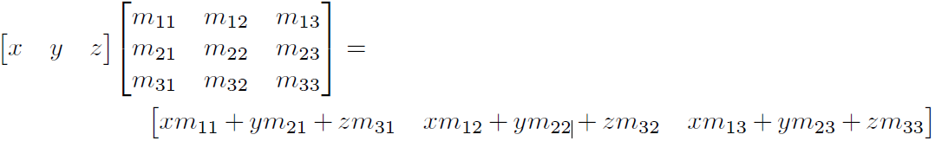
Row Vector Times Matrix Multiplication
Can multiply a row vector times a matrix

Slide 26
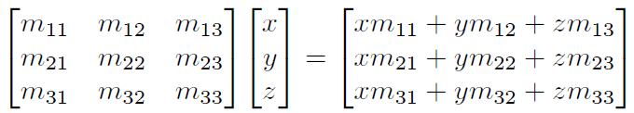
Matrix Times Column Vector Multiplication
Can multiply a matrix times a column vector.

Slide 27
Row vs. Column Vectors
Row vs. column vector matters now. Here’s why: Let v be a row vector, M a matrix.
vM is legal, Mv is undefined
Mv^{T} is legal, v^{T}M is undefined
DirectX uses row vectors.
OpenGL uses column vectors.

Slide 28
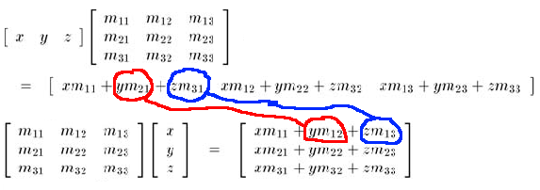
Common Mistake
Mv^{T} ≠ (vM)^{T}, but Mv^{T} = (vM^{T})^{T} – compare the following two results:

Slide 29
Vector-Matrix Multiplication Facts 1
Associates with vector multiplication.
Let v be a row vector:
v(AB) = (vA)B
Let v be a column vector:
(AB)v = A(Bv)

Slide 30
Vector-Matrix Multiplication Facts 2
Vector-matrix multiplication distributes over vector addition:
(v + w)M = vM + wM
That was for row vectors v, w. Similarly for column vectors.

Slide 31
Section 4.2: Matrix – a Geometric Interpretation

Slide 32
Matrices and Geometry
A square matrix can perform any linear transformation. What’s that?
Preserves straight lines
Preserves parallel lines.
No translation: the axes do not move.

Slide 33
Linear Transformations
Rotation
Scaling
Orthographic projection
Reflection
Shearing
More about these in the next chapter.

Slide 34
A Movie Quote
“Unfortunately, no-one can be told what The Matrix is – you have to see it for yourself.”
Actually, it’s all about basis vectors.
Look back to Chapter 3 if you’ve forgotten about those.

Slide 35
Axial Displacements
Can rewrite any vector v = [x y z] as a sum of axial displacements.
V = [x y z]
= [x 0 0] + [0 y 0] + [0 0 z]
= x [1 0 0] + y [0 1 0] + z [0 0 1]

Slide 36
Basis Vectors
Define three unit vectors along the axes:
p = [1 0 0]
q = [0 1 0]
r = [0 0 1].
Then we can rewrite the axial displacement equation as
v = xp +yq +zr
p, q, r are known as basis vectors

Slide 37
Arbitrary Basis Vectors
Can use any three linearly independent vectors
p = [p_{x} p_{y} p_{z}]
q = [q_{x} q_{y} q_{z}]
r = [r_{x} r_{y} r_{z}]
Linearly independent means that there do not exist scalars a,b,c such that:
ap + bq + cr = 0

Slide 38
Orthonormal Basis Vectors
Best to use an orthonormal basis
Orthonormal means unit vectors that are pairwise orthogonal:
p.q = q.r = r.p = 0
Otherwise things can get weird.

Slide 39

Matrix From Basis Vectors
Construct a matrix M using p, q, r as the rows of the matrix:

Slide 40
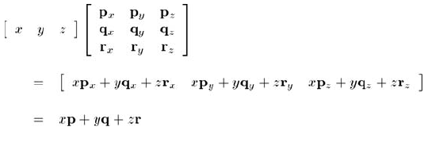
What Does This Matrix Do?

Slide 41
Transformation by a Matrix
If we interpret the rows of a matrix as the basis vectors of a coordinate space, then multiplication by the matrix performs a coordinate space transformation.
If aM = b, we say that vector a is transformed by the matrix M into vector b.

Slide 42
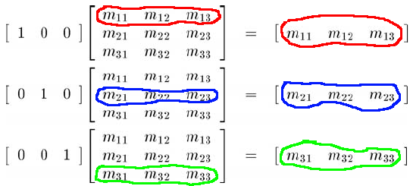
Conversely
See what M does to the original basis vectors [1 0 0], [0 1 0], [0 0 1].

Slide 43
Visualize The Matrix
Each row of a matrix is a basis vector after transformation.
Given an arbitrary matrix, visualize the transformation by its effect on the standard basis vectors – the rows of the matrix.
Given an arbitrary linear transformation, create the matrix by visualizing what it does to the standard basis vectors and using that for the rows of the matrix.

Slide 44

2D Matrix Example
What does the following 2D matrix do?
Extract the basis vectors (the rows of M)
p = [2 1]
q = [-1,2]

Slide 46
What’s the Transformation?
It moves the unit axes [1, 0] and [0, 1] to the new axes.
It does the same thing to all vectors.
Visualize a box being transformed from one coordinate system to the other.
This is called a skew box.

Slide 47
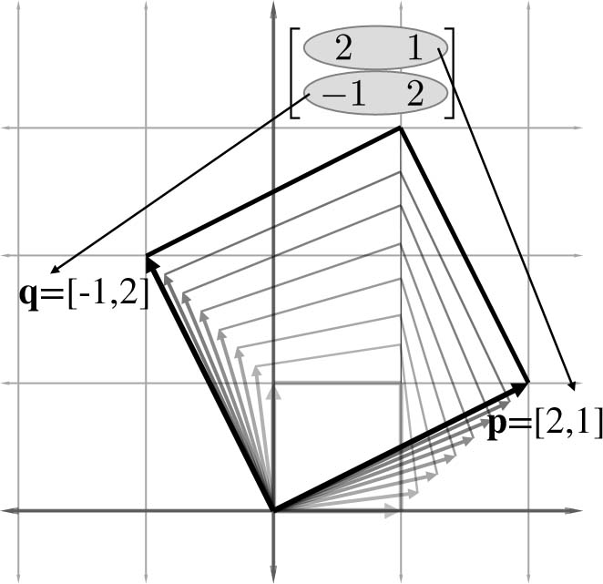

Slide 48
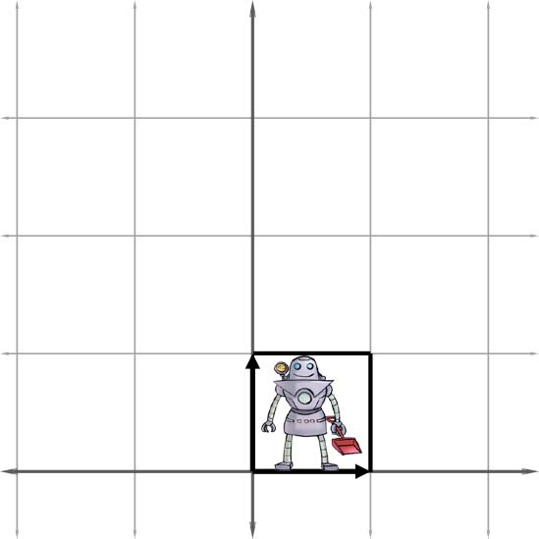

Before
After

Slide 49
So What Does It Do?
Rotates objects counterclockwise by a small amount.
Scales them up by a factor of two.

Slide 50
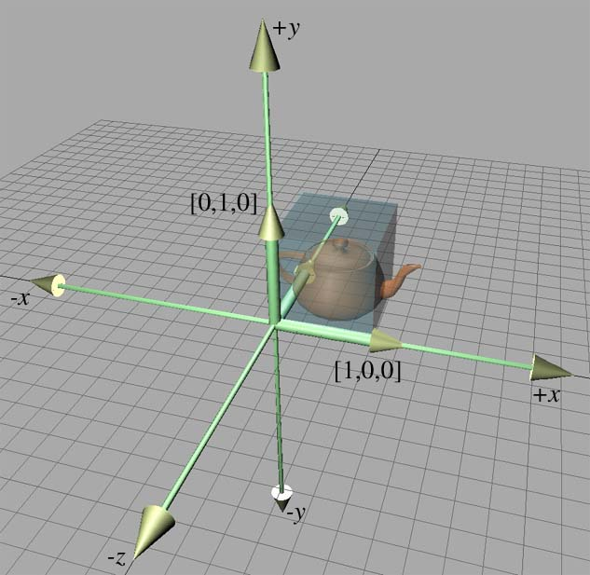
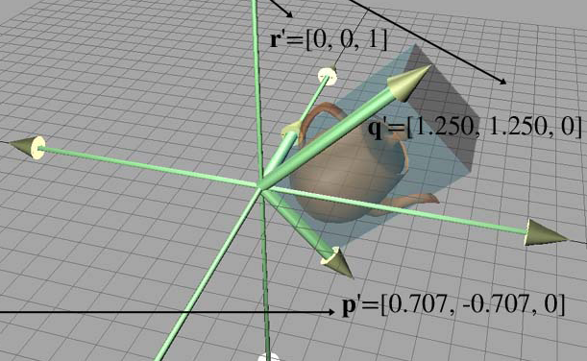
3D Transformation Example
After
Before

Slide 51


Slide 52
What’s the Matrix?
Get rows of matrix from new basis vectors.
So what does it do?
Rotates objects clockwise by 45°.
Scales them up along the y axis.

Slide 53
Constructing & Deconstructing Matrices
By interpreting the rows of a matrix as basis vectors, we have a tool for deconstructing a matrix.
But we also have a tool for constructing one! Given a desired transformation (e.g. rotation, scale, etc.), we can derive a matrix which represents that transformation.
All we have to do is figure out what the transformation does to basis vectors, and then place those transformed basis vectors into the rows of a matrix.
We'll use this tool repeatedly in Chapter 5 to derive the matrices to perform the linear basic transformations such as rotation, scale, shear, and reflection that we mentioned earlier.

Slide 54
That concludes Chapter 4. Next, Chapter 5: Matrices and Linear Transformations

